Slide 1
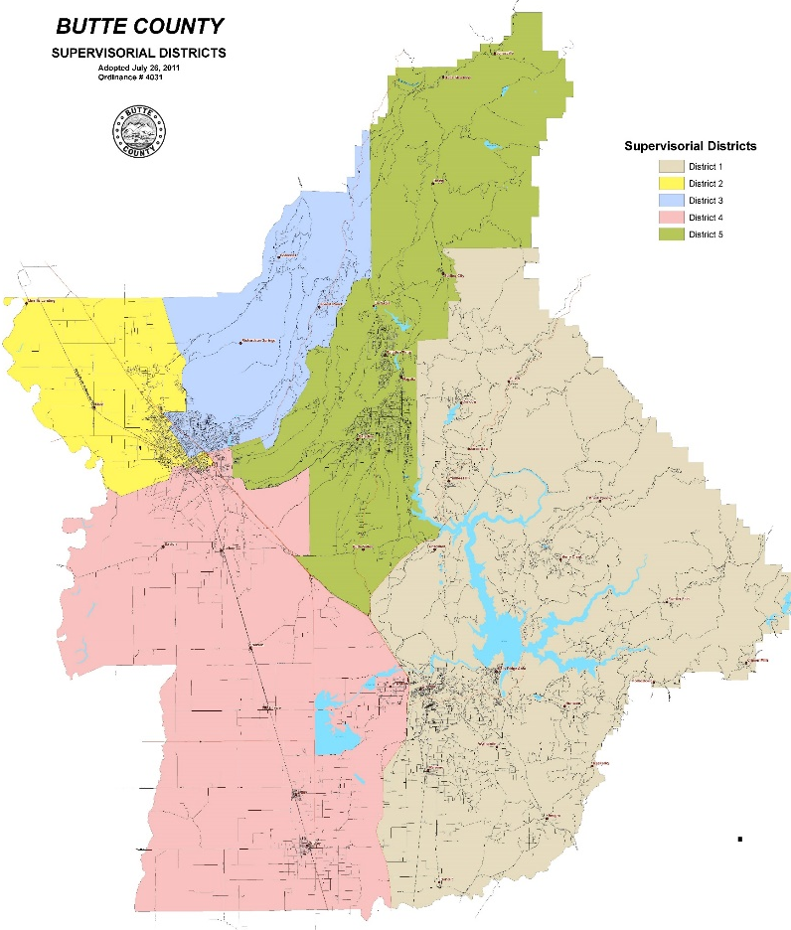
Butte County 2020 Communities of Excellence Multi-unit Housing Data Placemat (2.2.13)
2
1in5
Cities have a smoke-free MUH law: Pine Butte (2017) Salmon Falls (2008)
Residents live in multi-unit housing
Community Profile
Butte's population is more at risk than California overall.

Slide 2
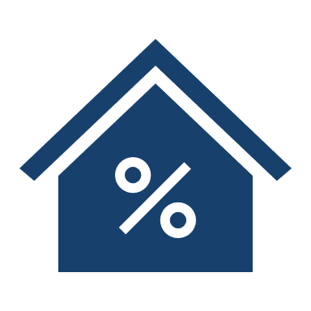
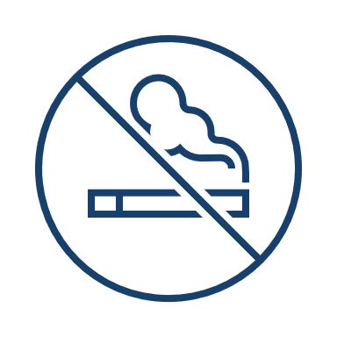
Butte County 2020 Communities of Excellence Multi-unit Housing Data Placemat (2.2.13) – page 2
25% of adults living in multi-unit housing smelled drifting smoke in the past 7 days (BRFS, 2019)
Secondhand smoke is the third most common complaint call received by the county health department
19% of adults surveyed (n=500) reported smoking inside their homes in the past 7 days (2019 Butte public opinion poll)
42% of county residents (n=824) who smoke/vape say they want to quit (2019 Community Needs Assessment)
The 2019 County Health Assessment Report listed tobacco and vape product use as a growing concern, particularly among vulnerable populations and youth. “We should make every attempt to discourage youth uptake and protect the population from the harms of drifting smoke/vapor.”
Note: Data used for placemat examples only; may not be factual

